Slide 1

Resumate
Week-3 Group-7
Saud| Anika| sakai | Rima
North South University | 2025

Slide 2
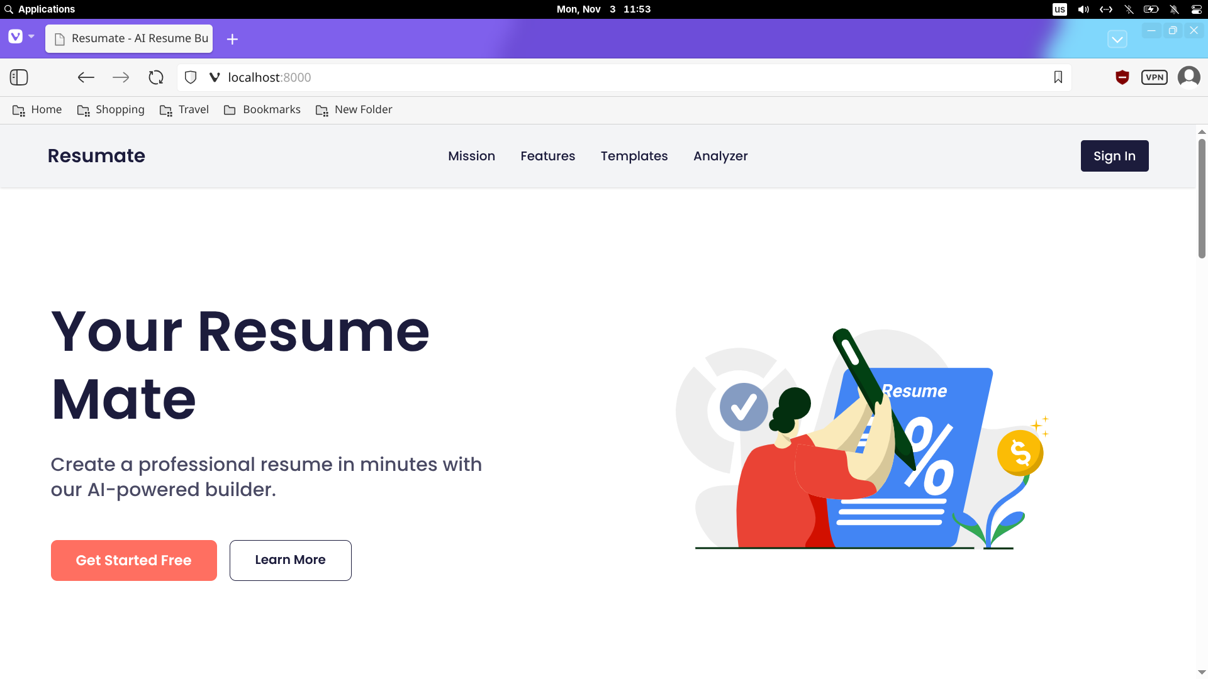
1
Fixed Hero image

Slide 3
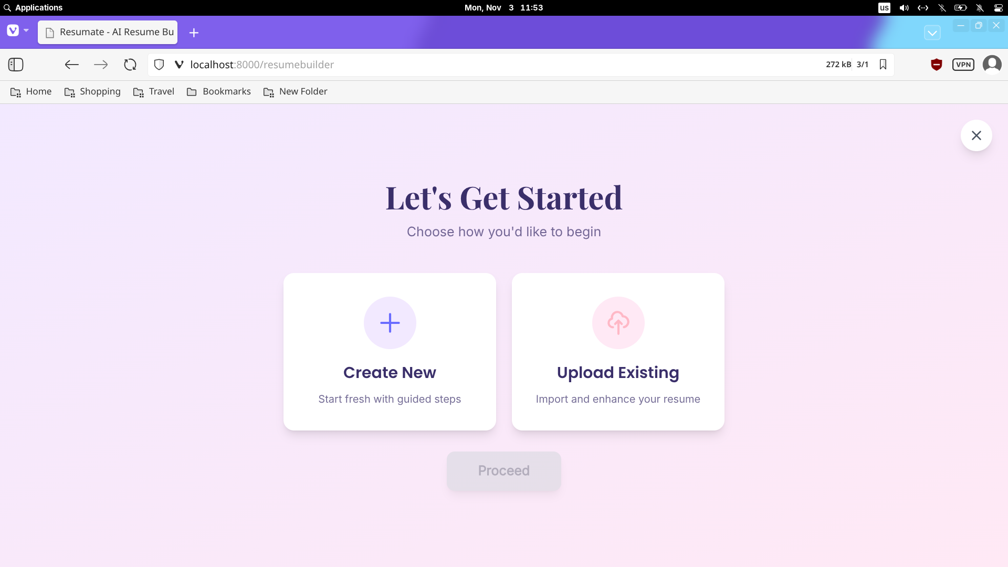
1
Resumebuilder

Slide 4
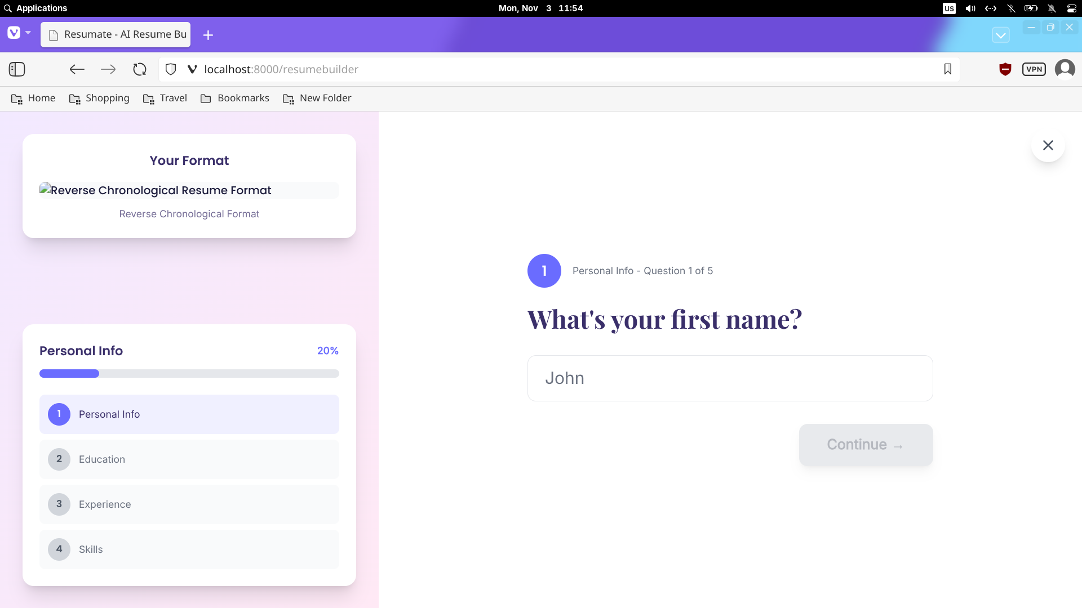
1
Questions with progress

Slide 5
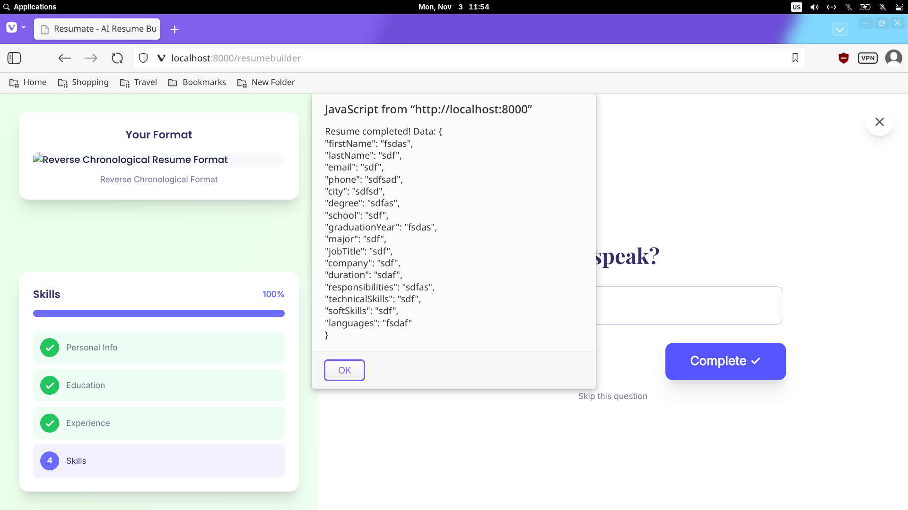
1
JSON output

Slide 6
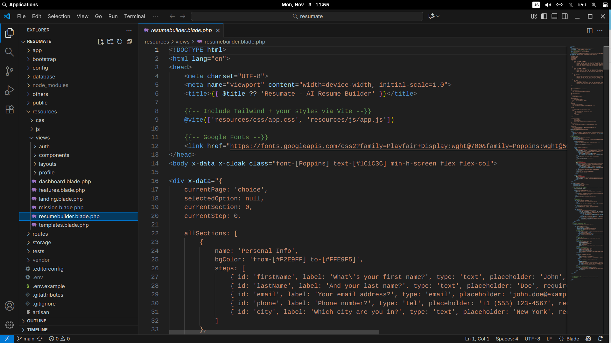
1
Code

Slide 7
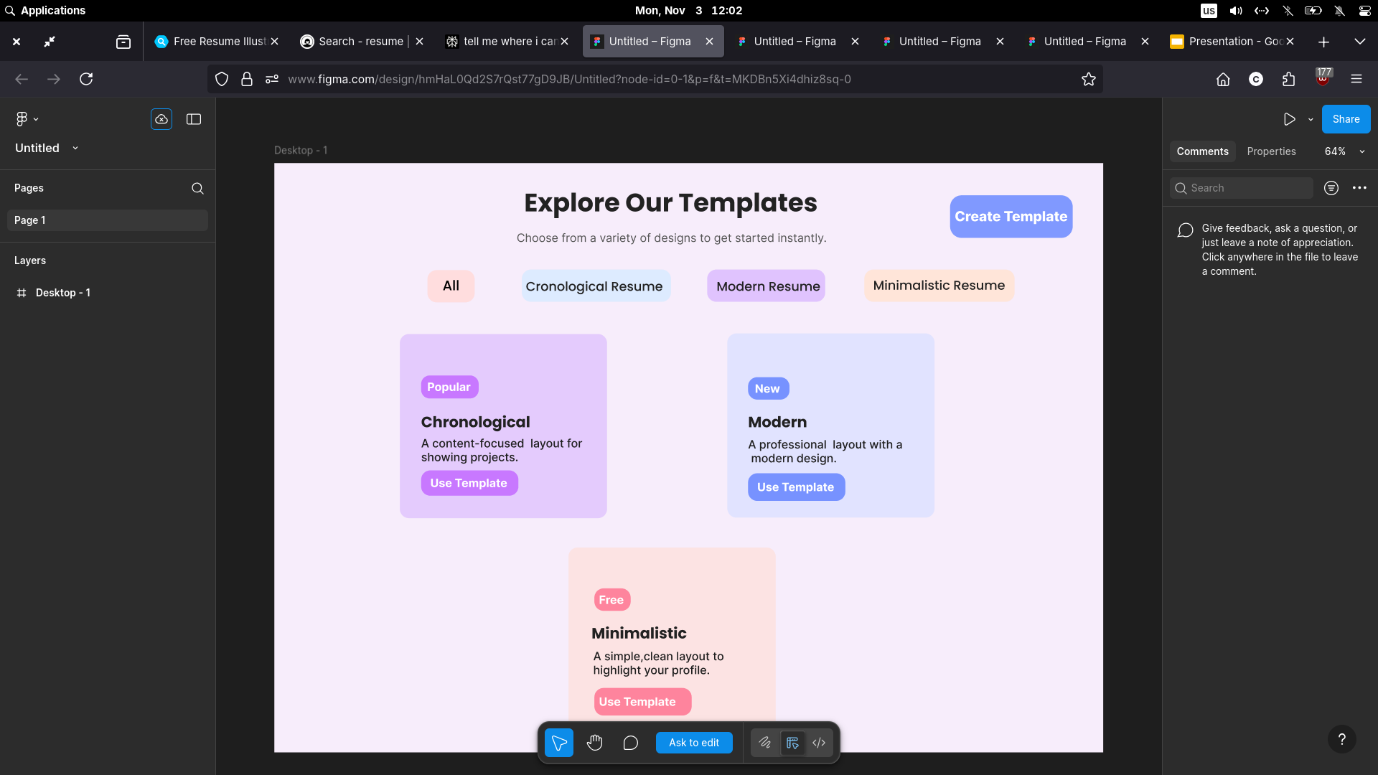
1
Figma

Slide 8
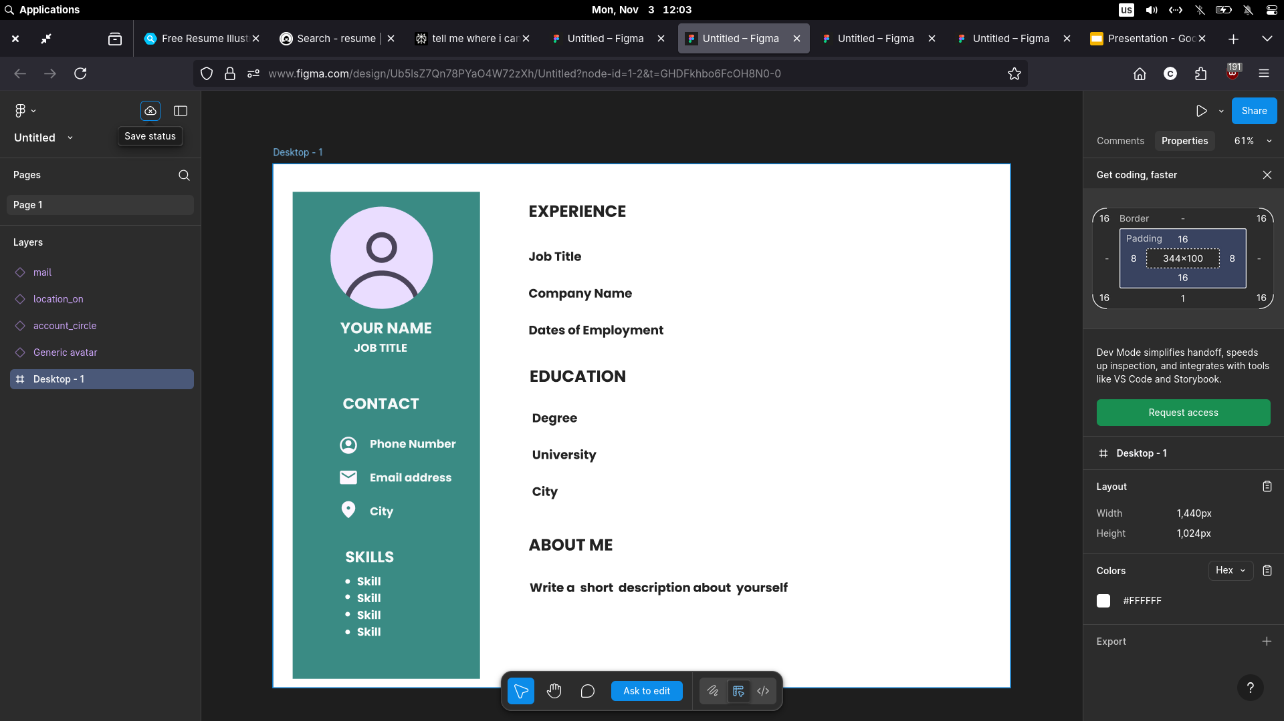
1
Figma

Slide 9
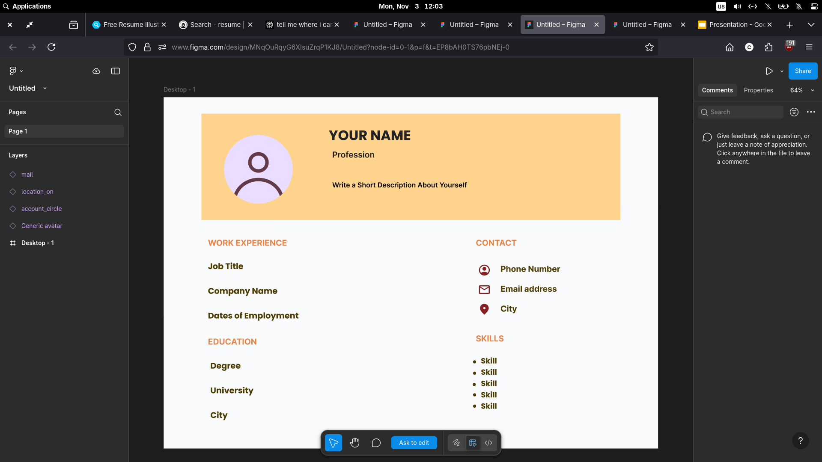
1
Figma

Slide 10
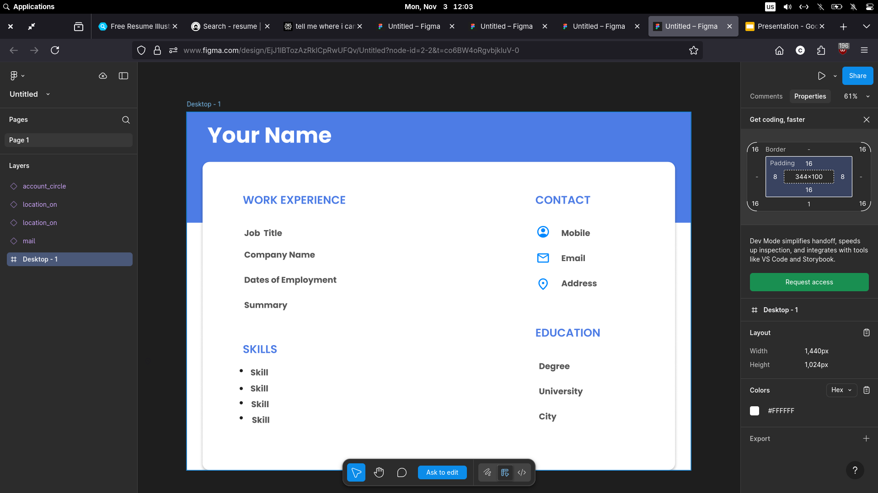
1
Figma

Slide 11
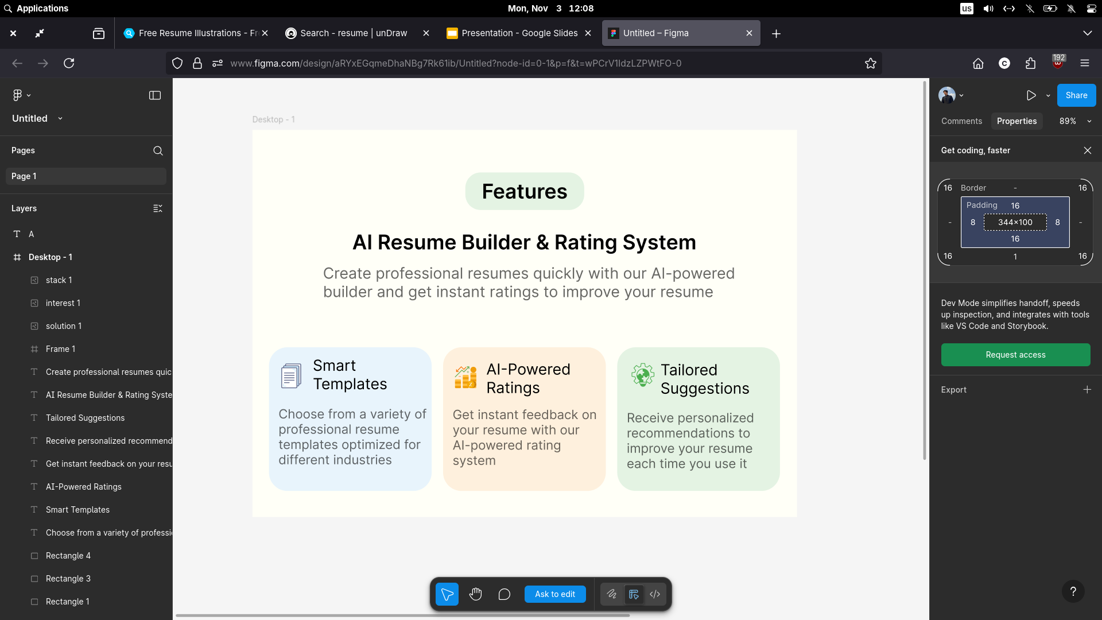
1
Figma

Slide 12
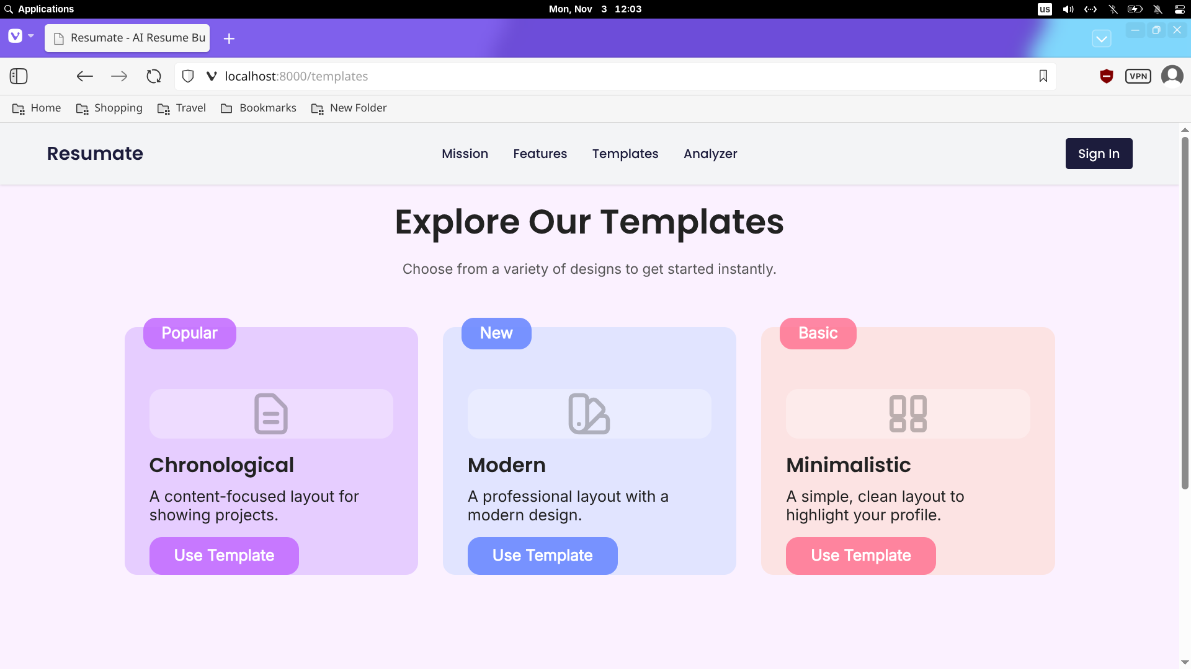
1
New templates

Slide 13
Thank You

